Slide 1
ERP systems
Imran Mahmud

Slide 2
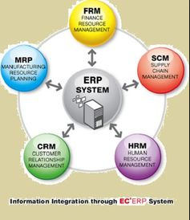
Definition
Enterprise Resource Planning (ERP) refers to large commercial software packages that promise a seamless integration of information flow through an organization by combining various sources of information into a single software application and a single database.
E.g. SAP, Oracle, IBM, PeopleSoft

Slide 3
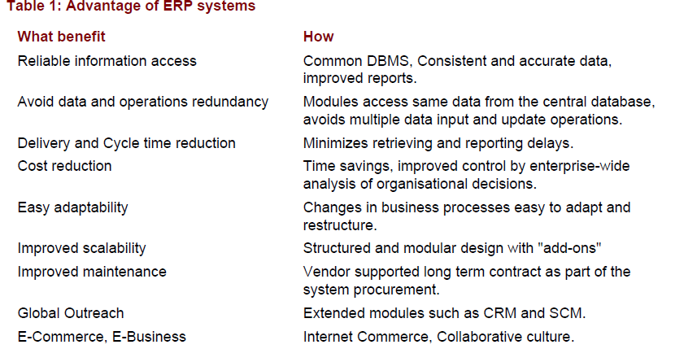

Slide 4
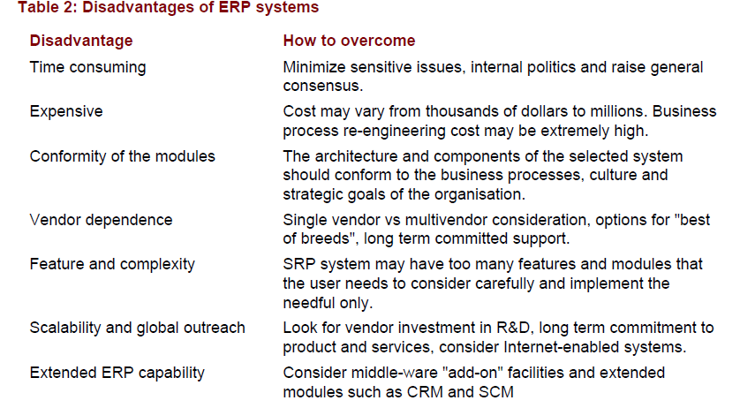

Slide 5
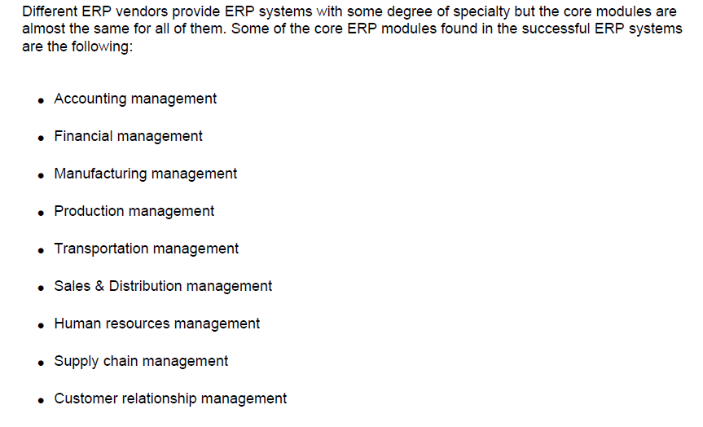
Different Modules

Slide 6
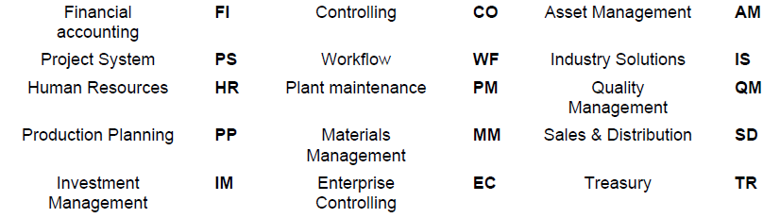
ERP modules

Slide 7
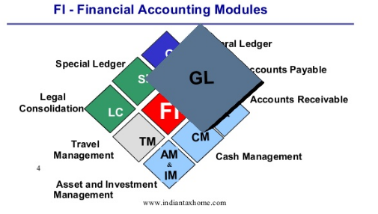
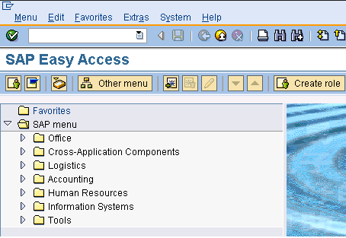
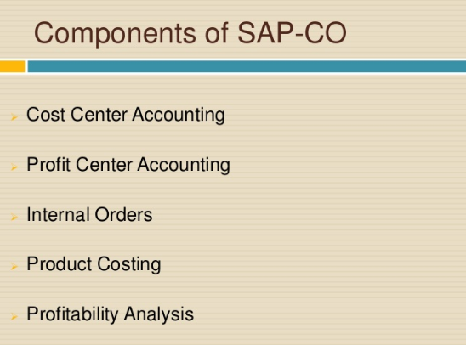
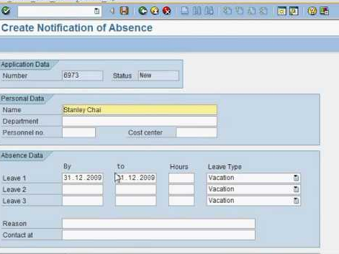

Slide 8
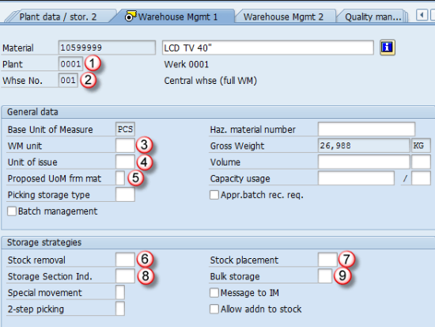
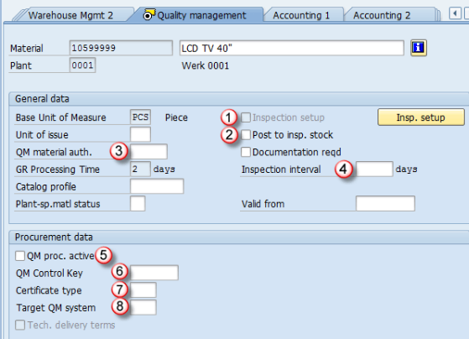
Material Management
Quality Management

Slide 9
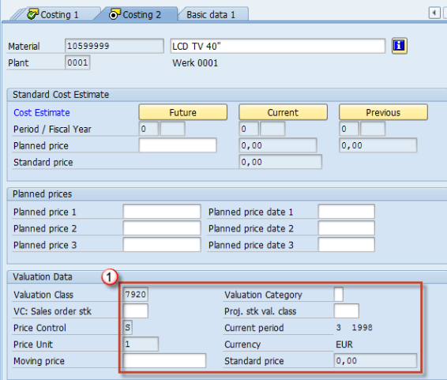
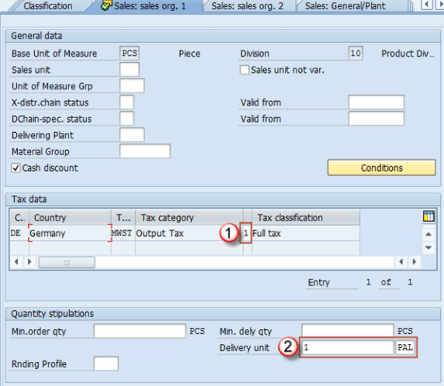
Sales
Costing

Slide 10
ERP life cycle
Adoption decision phase During this phase managers examine the need for a new ERP system while selecting the general information system approach that will best address the critical business challenges and improve the organizational strategy. This decision phase includes the definition of system requirements, its goals and benefits, and an analysis of the impact of adoption at a business and organizational level.

Slide 11
Acquisition phase This phase consists on the selection of a ERP product that best fits the requirements of the organization, thus minimizing the need for customization. A consulting company is also selected to help in the next phases of the ERP life-cycle especially in the implementation phase. Factors such as price, training and maintenance services are analyzed and, the contractual agreement is defined. In this phase, it is also important to make an analysis of the return on investment of the selected product.

Slide 12
Implementation phase This phase include the customization or parameterization and adaptation of the ERP package to the needs of the organization. Usually this task is made with the help of consultants who provide implementation methodologies, know-how and training.
Use and maintenance phase This phase covers the personal of time where the ERP product is selected in a way that returns benefits and minimizes disruption. During this phase, one must be aware of the aspects related to functionality, usability and adequacy to the organizational and business processes. Once a system is implemented, it must be maintained, because malfunctions have to be corrected, special optimization requests have to be met, and general systems improvements have to be made.

Slide 13
Evolution phase This phase corresponds to the integration of more capabilities into the ERP system, providing new benefits, such as advanced planning and scheduling, supply-chain management, customer relationship management, workflow, and expanding the frontiers to external collaboration with other partners.
Retirement phase This phase corresponds to the stage when, with the appearance of new technologies or the inadequacy of the ERP system or approach to the business needs, managers decide if they will substitute the ERP software with other information system approach more adequate to the organizational needs of the moment.

Slide 14
Three layers of ERP
Presentation Layer: Graphical User Interface (GUI) or browser for data entry or accessing system functions.
Application Layer: Business rules, functions, logic, programs acting on data received/transferred from/to the database servers.
Database Layer: Management of the organizations' operational or transactional data including metadata. Mostly employs industry standard RDBMS with structured query language (SQL) provisions

Slide 15
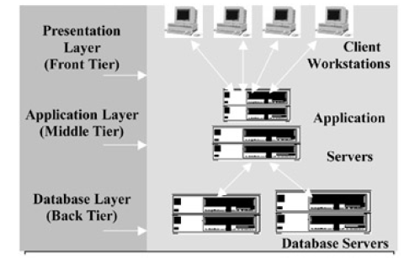
Diagram

Slide 16
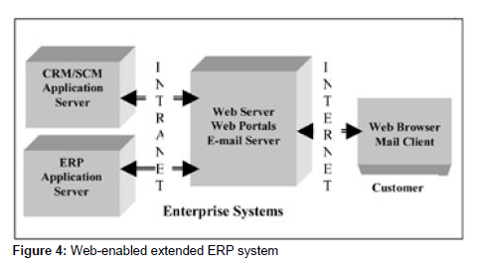
ERP and Internet

Slide 17
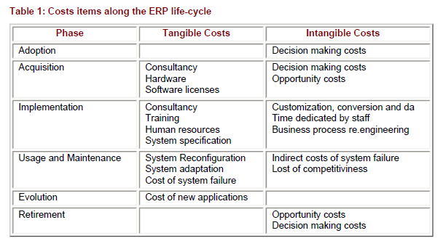
Costs and ERP life cycle

